Slide 1

NodeJS
Training Document
By ChauNNT@MakeFamousApp.com

Slide 2
Why I chose these boilerplates to train
Clear structure for model, controller, route, utils, functions
Meet requirement for long-term projects which must have translation module, third-party modules, configurable, high availability.
Have long-term supports

Slide 3
Boilerplates
Boilerplates is a template source code for a sample project. It is much function than a simple template for single functions. It usually was built & collected from a real project.
We will have two boilerplates in this training:
Hapi with MongoDB (No SQL database)
Express with SQL (MSSQL, MySQL, PostgreSQL...etc. Databases may have slight differences but they are all SQL)

Slide 4
Hapi with MongoDB
Server initial files
package.json: contains libraries and their version, commands to run server (ex: npm run, npm start)
Server.js: server init file
.env: environment variables which can be use like global constants

Slide 5
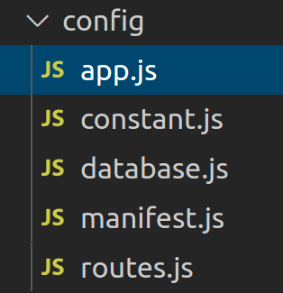
Hapi with MongoDB
“Config” folder: contains configurations
App: setting for app (like global config) such as JWT key, documentation, logger, api version
Constant: global constant
Database: database connections
Manifest: define server connection (host / port)
Routes: define all routes of server

Slide 6
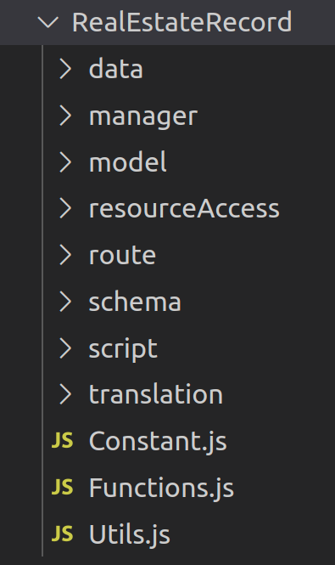
Hapi with MongoDB
“Common” and <Modules name> folder: contains source code of APIs modules
Route: define process of routes of this module (verify headers, body, permission, jwt, etc)
Manager: define process of controller / manager of modules
resourceAccess: define function to query database
Model: define models of this module. We use “Model-first” pattern. It means we will define model first, and database will create documents (table) and records follow structure of model
Functions.js: logic functions of this modules which are usually used by manager. They can be reused by other modules
Constant.js, Utils.js: define constant and utils functions in this module ONLY
Schema, script, translation, data: add these folder if needed when our source code is too heavy. We will split source code to these folder.
Notes: “Common” folder is like other <modules name> folder but they only contains common functions.
For example: all modules will have insert , delete , update , select all , count query for database which only have different in module name. Then we will create common function for insert, delete, update,etc to reduce line of code and make our code more reusable

Slide 7
Hapi with MongoDB
Others:
Third-party: contains wrapper for third-party modules. We must wrap them with our code to prevent effect of third-party. For example:
when we add redis functions (cache functions) in manager of “user” module to cache data of user login, if redis was upgraded to new version, our manager will be broken. We need to modify manager and retest everything related to this “user” module again.
When we wrap third-party modules with our code, we only need to retest our wrapper only, no need to retest “user” module
Test: contains unit test for APIs
Utils: contains utils functions
.github: Github Actions for CICD
Dockerfile: docker for deployment

Slide 8
Practice
Create APIs to insert, delete, update, view detail, view list of books
Insert new API in “config > route”
Create a module folder “Books” (can be copied from RealEstate)
Modify API function for “Books > route”
Insert function for manager in “Books > manager”
Create query database method in “Books > resourceAccess”
Create function to call query method (from step 5) in “Books > Functions.js
Call functions from step 6 in manager and response value to client
Run “npm start” and check API in 0.0.0.0:9999/documentation
Create unit test case and execute automation test (use “npm run test” command)
Expected result:
API appears in Swagger and can be used by user via swagger
API can be used via PostMan tool
All APIs have at least 1 normal unit test case and 1 abnormal unit test case and All unit test cases must be passed

Slide 9
Reference
Boilerplate’s source code:
https://github.com/chaunnt/TemplateNodeJSWithMongoose
Hapi framework:
https://hapi.dev/

Slide 10
ExpressJS with SQL
Server initial files
package.json: contains libraries and their version, commands to run server (ex: npm run, npm start)
app.js: server init file
.env: environment variables which can be use like global constants

Slide 11
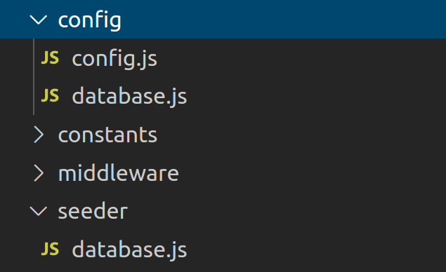
ExpressJS with SQL
“Config” folder: contains configurations
config: setting for app (like global config) such as JWT key, documentation, domain whitelist to use API, host, port
Database: database connections
Seeder: contain js file to run seeding (init database)

Slide 12
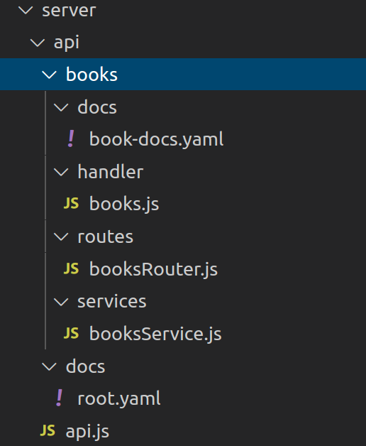
ExpressJS with SQL
“api/<Modules name>” folder: contains source code of APIs modules
docs: define document for APIs (swagger will be rendered based on this, remember to have “-docs.yaml” in file name)
handler: define process of controller / manager of modules
services: define function to query database
routes: define process for each route of these API

Slide 13
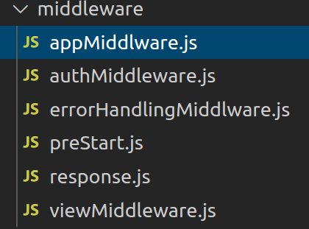
ExpressJS with SQL
Middlewares:
appMiddleware: setting for global app
authMiddleware: authentication (verify user, token, etc)
errorHandlingMiddleware: handle response when app throws errors
preStart: pre-processing to run before calling APIs
Response: response template
viewMiddleware: NOT-IN-USE, only use when we implement front-end with expressjs

Slide 14
Practice
Create APIs to insert, delete, update, view detail, view list of newspaper
Create a module folder “Newspaper” in server/api/
Add route to server routes in “server/api.js”
Create swagger for “Newspaper” in “docs”
Insert API for newspaper in “routes”
Insert handler for newspaper in “handler”
Create query database method in “Newspaper > services”
Call functions from step 6 in manager and response value to client
Run “npm start” and check API in http://localhost:4001/api/docs/#
Create unit test case in “test” and execute automation test (use “npm run test” command)
Expected result:
API appears in Swagger and can be used by user via swagger
API can be used via PostMan tool
All APIs have at least 1 normal unit test case and 1 abnormal unit test case and All unit test cases must be passed

Slide 15
Reference
Boilerplate’s source code:
https://github.com/chaunnt/TemplateNodeJS_ExpressJS_SQL
Knex Library:
https://knexjs.org/
Chaijs library:
https://www.chaijs.com/api/bdd/

Slide 16

Let’s dig in

